Slide 1

Why Use APIs for Social Science Research?
Aspen Russell, CCSS Data Science fellow, Cornell University
Jonathan Chang, CCSS Senior Data Science Fellow, Cornell University

Slide 2
Cornell Center for Social Sciences (CCSS)
The Cornell Center for Social Sciences provides a welcoming environment for everyone embracing all backgrounds or identities. All instructors and attendees agree to abide by our community norms. We encourage the following behaviors in our workshops:
Respect differing viewpoints and ideas
Share your own perspectives and ask any questions
Accept constructive criticism
Use welcoming and inclusive language
Show courtesy and respect for all instructors and attendees
If you believe that an instructor or attendee has violated the code of conduct, please report the violation to ccss-researchsupport@cornell.edu. We take all reported incidents seriously.

Slide 3
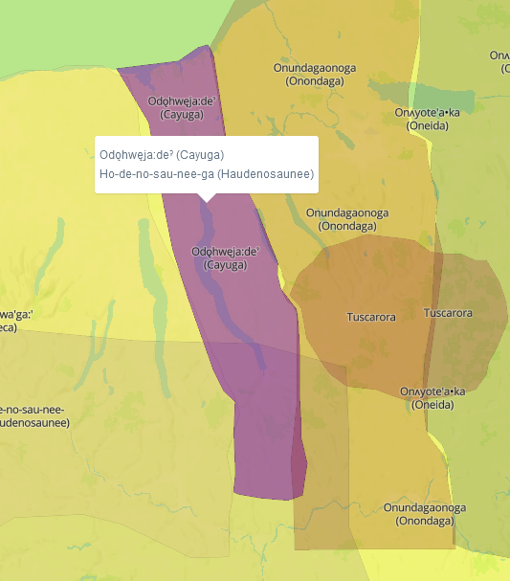
Land Acknowledgement
Cornell University is located on the traditional homelands of the Gayogo̱hó꞉nǫ' (the Cayuga NatiCCSS-RS@cornell.eduon). The Gayogo̱hó꞉nǫ' are members of the Haudenosaunee Confederacy, an alliance of six sovereign Nations with a historic and contemporary presence on this land. The Confederacy precedes the establishment of Cornell University, New York state, and the United States of America. We acknowledge the painful history of Gayogo̱hó꞉nǫ' dispossession and honor the ongoing connection of Gayogo̱hó꞉nǫ' people, past and present, to these lands and waters.
- American Indian & Indigenous Studies Program (AIISP), Cornell University
Here for more on the history of Cornell’s violent, colonial formation, the movement to return native lands, and about the AIISP program at Cornell.

Slide 4
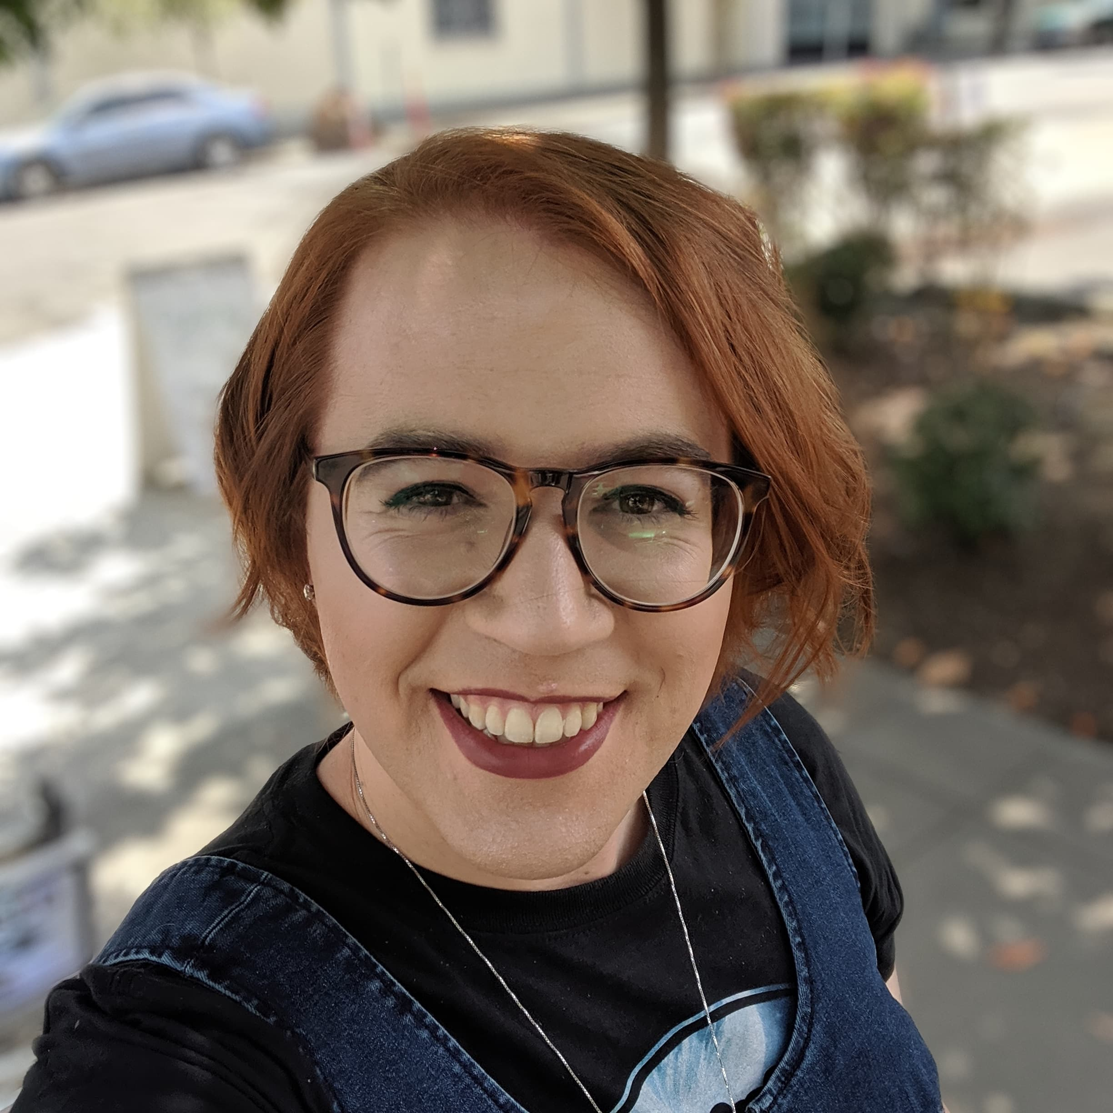
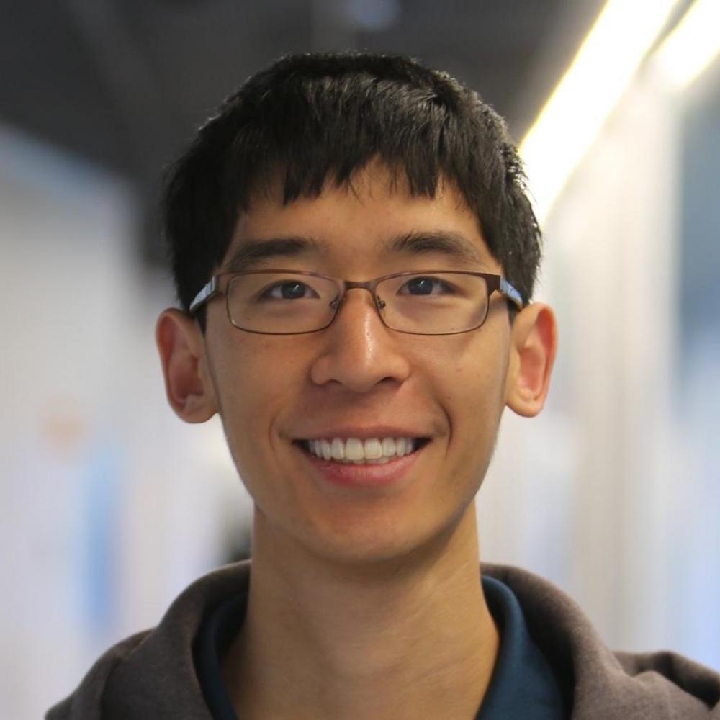
About the presenters:
Aspen Russell
PhD Student in Information Science
Norms in Online Communities
Hate speech, harassment, and misinformation
Has worked with: Reddit, Twitter, Facebook, arXiv, YouTube, and more.
Moonlights as a Dungeon Master
Jonathan Chang
PhD Candidate in Computer Science
Online content moderation
Making online interactions healthier
Has worked with: Reddit, Facebook, Wikipedia
Slowly grinding the new level cap in Pokémon Go

Slide 5
The API Workshop series
2/9: API Workshop 1
What are API’s and what can they do for you?
2/21: API Workshop 2
Practical Application of the Twitter API
TBD: API Workshop 3
Research Design and Data Collection

Slide 6
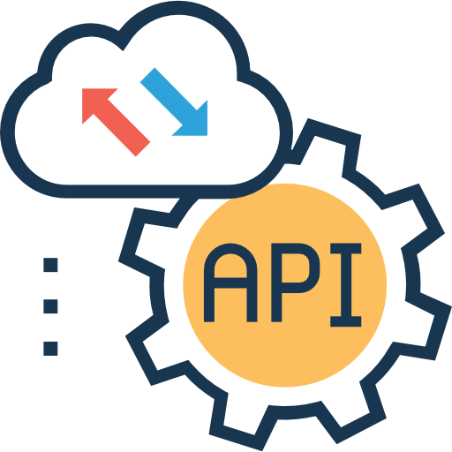
Why apis?
What if you had behavioral evidence of a hypothesis, theory, or phenomena you cared about?
What if you had 1000x as many examples of that behavior?
What if you had access to context surrounding that behavior?

Slide 7


Examples of API data use
Social Media
User timeline of posts (change over time?)
Hashtag posts (perhaps an activist movement)
Tweets from a period of time (election)
Investigating comments before and after a moderation change
Traditional Text (books, academic articles, etc)
Co-authorship networks
Publication reach based on identity
Influence networks (who started what)
Change over time (how do words change in meaning)

Slide 8
What brought you here today? (Breakout rooms)
Notes:
Who You Are
What You Do (methods, research areas)
What you hope to learn today/in this series?

Slide 9



What is an api?
You
API
Platform
Can we make that?
Do we have those ingredients?
Order
Finished Meal
Notes:
HOW IS THIS DIFFERENT VS WEB SCRAPING

Slide 10
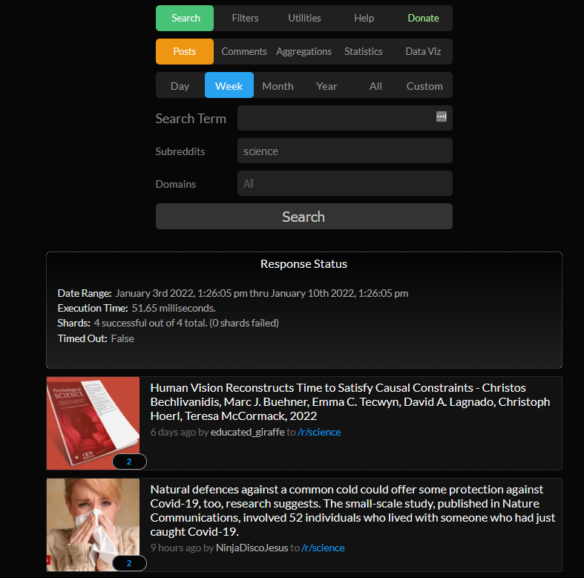
LIVE api demo: Reddit API via Pushshift
Notes:
https://api.pushshift.io/reddit/search/comment/
https://api.pushshift.io/reddit/search/comment/?q=Cornell
https://api.pushshift.io/reddit/search/comment/?q=Cornell&subreddit=ApplyingToCollege
https://api.pushshift.io/reddit/search/comment/?q=Cornell&subreddit=ApplyingToCollege&after=2021-06-01&before=2021-09-01

Slide 11






What’s out there? Programming Packages/Tools
RedditExtractoR
FORT API
academictwitteR
tubeR
PRAW: The Python Reddit API Wrapper
FORT API
search-tweets
python-youtube

Slide 12
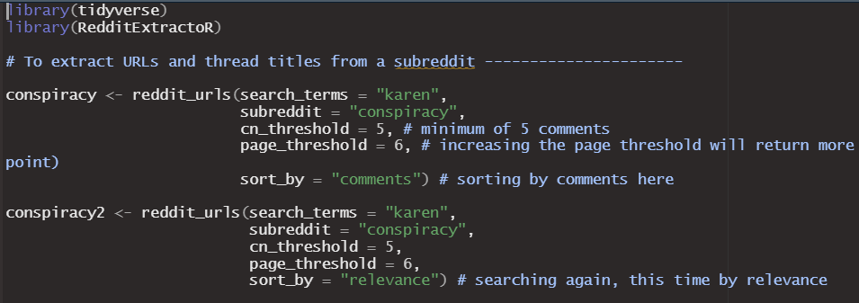
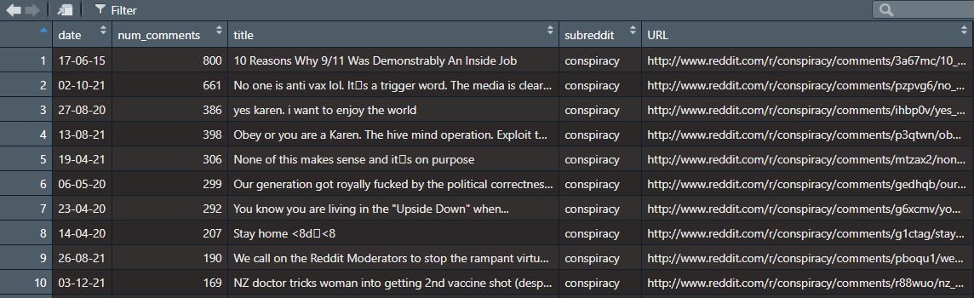
Reddit extractor
The Query ->
<- The Output

Slide 13
What’s next for the api series?
2/9: API Workshop 1
What are API’s and what can they do for you?
2/21: API Workshop 2
Practical Application of the Twitter API
TBD: API Workshop 3
Research Design and Data Collection
Data from scratch!

Slide 14
Q&A (Thank you!)
Aspen Russell
Information Science PhD Student, Cornell University
aspen@infosci.cornell.edu
@InfoTisayentist on Twitter
Jonathan Chang
Computer Science PhD Candidate, Cornell University
jpchang@cs.cornell.edu
u/GradientDissent on Reddit

Slide 15
Attributions
Icons sourced from flaticon.com and from these artists: freepik, flaticon, becris, Yellowline, vidyavidz, Pixel perfect, and Prosymbols

